Slide 1
How to interpret your own genome.
C. Titus Brown
ctbrown@ucdavis.edu
@ctitusbrown
http://ivory.idyll.org/blog/
Second in my ongoing attempt to explain what I actually do to Terry Peppers.

Slide 2
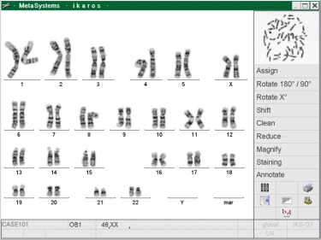
Some basic facts about DNA
The primary DNA sequence consists of strings of A, C, G, and T.
Most human cells contain approximately 6 billion of these.
They are divided into 23 chromosome pairs.
These chromosomes are the primary unit of heredity.
http://classes.biology.ucsd.edu/bimm110.SP07/lectures_WEB/L08.05_Cytogenetics.htm

Slide 3
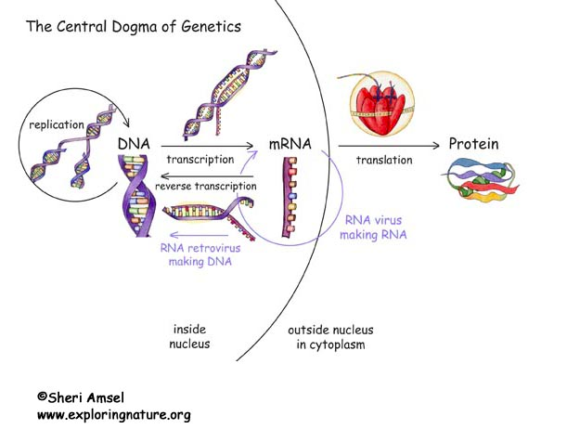
How DNA is interpreted – “It’s complicated.”
http://www.exploringnature.org/db/detail.php?dbID=106&detID=2454

Slide 4
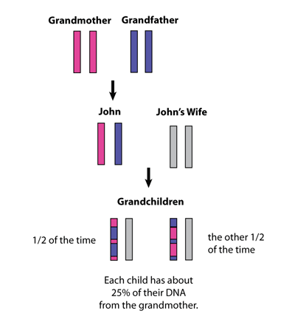
How inheritance & generation of variation works
+ approximately 300-600 mutations
per generation
http://genetics.thetech.org/ask/ask435

Slide 5
If we knew a person’s genome sequence perfectly…
We still wouldn’t know all that much!
We could correlate variation between genomes with diseases.
We could identify parentage and genetic inheritance.
We could probably identify ethnic origin.
We could find known “mistakes” or problems.

Slide 6
But… why wouldn’t we know that much?? Isn’t the genome the person?
Let’s ignore environmental factors, first of all…

Slide 7
Imagine…
…you’re locked in a room, with feral lawyers roaming around outside;
You have a bunch of source code on a stack of CDs to understand;
And you’ve been given a Windows 98 machine with Python installed.
(see David Beazley, “Discovering Python”, PyCon 2014)
This talk came partly from listening to his talk…

Slide 8
This “locked room” problem is a pretty good analogy to genomics!
“Here are 3 billion characters of DNA! Go figure out what it all means!”
It’s like the previous locked room problem, and:
The code is all written in Perl 8, for which neither a specification or software interpreter exists.
But you have access to the Internet and a world-wide collection of other scientists, and (some of) their data and papers.
Oh, and: the answers hold the keys to life and death.

Slide 9
Genomes are still useful! How do we find sequence?
Primary approach for human genomes is: spend a lot of money sequencing one, or a few; use that as reference.
Initial cost: $2.7 bn (in 1991)
Current human genome reference is from 13 anonymous volunteers in Buffalo, NY (Wikipedia ;)
Older technology: identify points of variation, then target for further investigation.
Current technology: sequence. (The rest of this talk.
Next technology: longer reads. (Sequence more, better.)

Slide 10
Working with short read sequencing - overview

Slide 11
Working with short read sequencing - sequencing
Need about 250 ng of DNA at 2 ng/ul.
“Under $1,000 dollars”
http://biome.biomedcentral.com/welcome-to-the-1000-genome/
…some up front investment required :)

Slide 12
Working with short read sequencing - sequencing
Raw data looks something like this (x 2 bn)
@D00360:18:H8VC6ADXX:1:1103:1434:46766/1
AACCCCCTCCCCATGCTTACAAGCAAGTACAGCAATCAACCCTCAACTATCACACATCAACTGCAACTCCAAAGCCACCCCTCACCCACTAGGATACCAACAAACCTACCCACCCTTAACAGCACATAGTACATAAAGCCATTTACCG
+
@@@DDDDDFHHFHHIIIBHGIIDGIA;EDGD@CG@FDDEFFB@DCGHGGIG8CHGDFGHCCDA>EEAAHEDFE?@@CEEBB?BBBB?<@<CCCC>CCCC>88ABBBCCCBAA@BBBCCCC@@<C??>C@CD>@@CACCC@9@C:CD@0

Slide 13
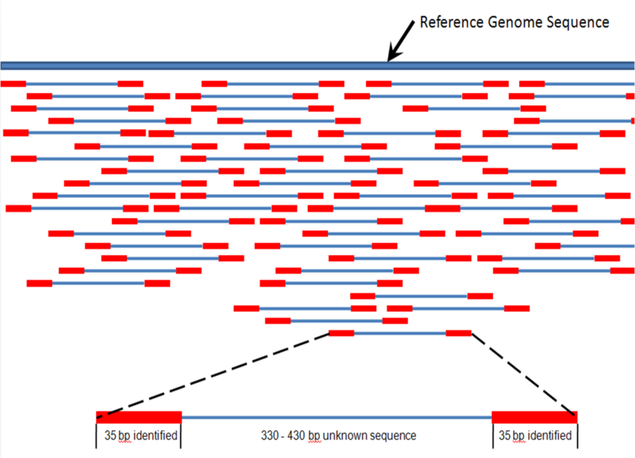
Mapping: locate sequences in reference
http://en.wikipedia.org/wiki/File:Mapping_Reads.png
FASTQ =>
=> BAM

Slide 14
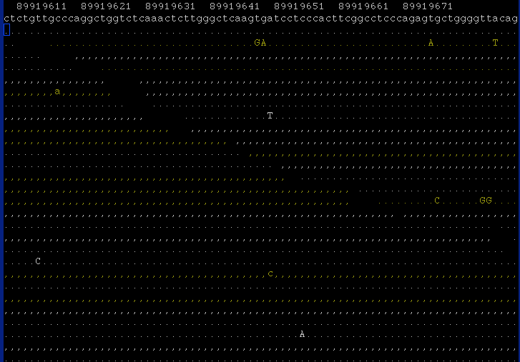

Slide 15
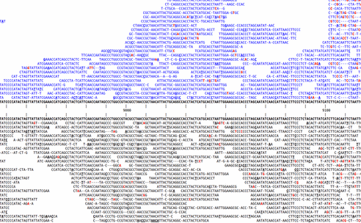
Variant detection after mapping
http://www.kenkraaijeveld.nl/genomics/bioinformatics/
BAM =>
=> VCF

Slide 16
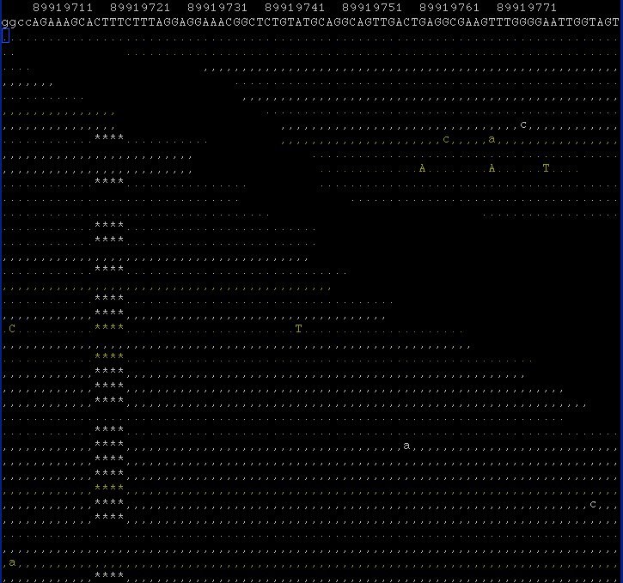

Slide 17
Working with short-read sequencing – annotate variants
Is it a variant known to have an effect?
Is it in a gene?
Is it in a gene and does it have some “obvious” effect (e.g. breaking the gene)?
Has it been associated with some effect?

Slide 18
Pipeline, approaches, formats, technologies.
Illumina
BWA
Samtools
VEP
SNPedia
Gemini
FreeBayes
bcbio →
~100 hours
~1500 hours
~12 hours
See http://ivory.idyll.org/blog/2015-pycon-talk.html for details.

Slide 19
An example data set
Sequences from a “trio” (son, father, mother) of Ashkenazi Jews are available, together with medical records (see links in blog post).
The Ashkenazim branched off from other Jews ~2500 years ago, flourished during Roman Empire, then “went through a 'severe bottleneck' as they dispersed, reducing a population of several million to just 400 families who left Northern Italy around the year 1000.”
http://en.wikipedia.org/wiki/Ashkenazi_Jews#Genetics

Slide 20
“Raw” human data:
BAM file: 108 GB
(contains sequences + quality scores)
+ human genome (~3 GB or so)
+ lots of databases of varying size.
Full instructions at:
http://ivory.idyll.org/blog/2015-pycon-talk.html

Slide 21
Working with short-read sequencing – mapping.
Software such as BWA takes in a reference genome and a set of reads and yields tab-delimited output:
D00360:37:HA3HMADXX:1:2104:14000:62852 163 chr22 16050001 15 87S8M1I10M1D41M1S = 16050476 621 CCA…. 3((…
This contains information about where each read maps, how well it maps, etc.

Slide 22
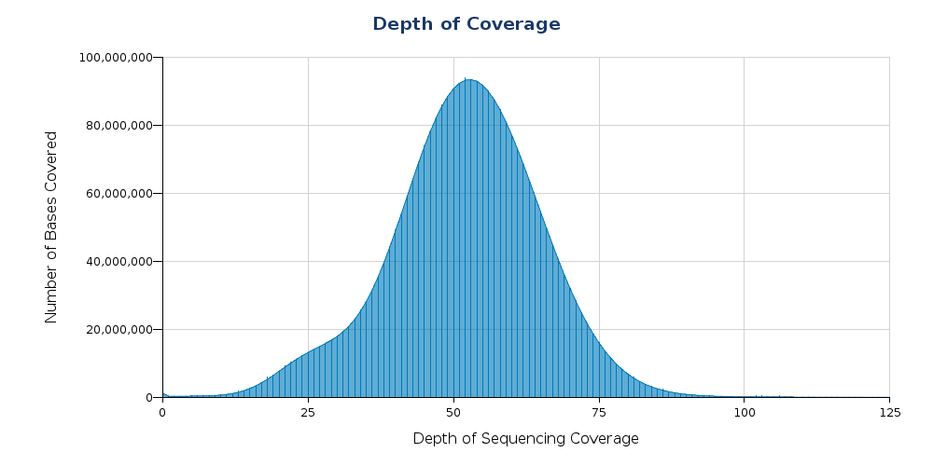
Most parts of the genome are sampled many times (~50, here)
HG002 data set

Slide 23
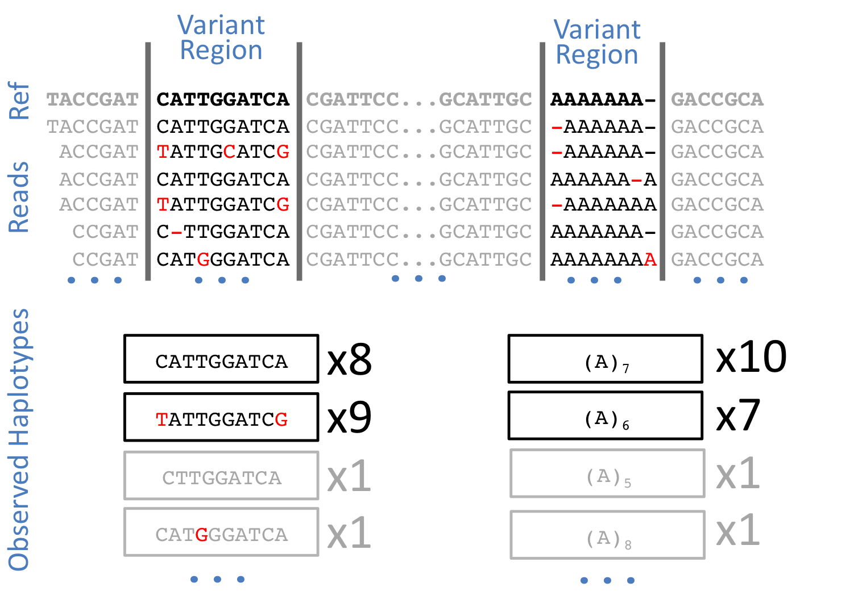
Calling variants w/FreeBayes
https://github.com/ekg/freebayes

Slide 24
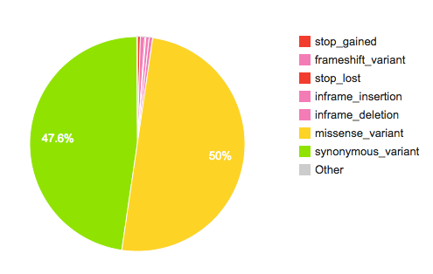
Working with short-read sequencing – annotate variants
Variants annotated with VEP using Gemini.
HG002 data set

Slide 25
Most differences are ~uninterpretable!
Total variants: | 5,562,545
Between genes: | 3,032,670
Between parts of genes (exons): | 2,014,962
Remaining: | 514,913
(Only 2% of human genome makes genes; maybe ~5% of genome thought to be functional)
HG002 data set

Slide 26
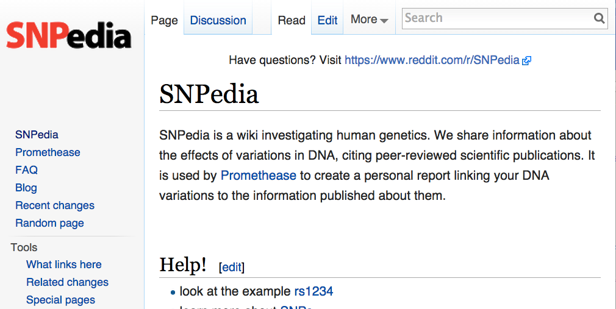
OK, you’ve got your variants – now what??
HT to Slate Star Codex,
http://slatestarcodex.com/2014/11/12/how-to-use-23andme-irresponsibly/

Slide 27
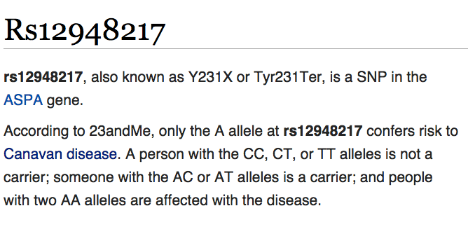
Chasing down a disease-related variant: Canavan disease.
http://www.snpedia.com/index.php/Rs12948217

Slide 28
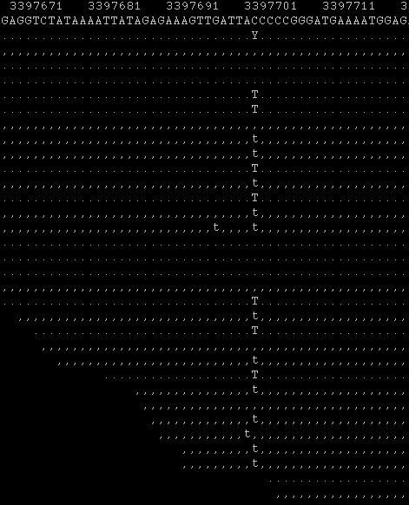
chr17:3397702 (hg19) in HG002 sample (son)
The son and both parents are heterozygous (1/2) for this – they are carriers, but not afflicted with disease.
¼ of their children would have homozygous allele and probably be affected by Canavan’s Disease:
“Children who inherit two copies of the gene appear normal at birth, but between three and nine months of age they begin to show symptoms ... These children cannot sit, crawl, or talk, and few live past age 10.”
http://www.snpedia.com/index.php/Canavan_disease

Slide 29
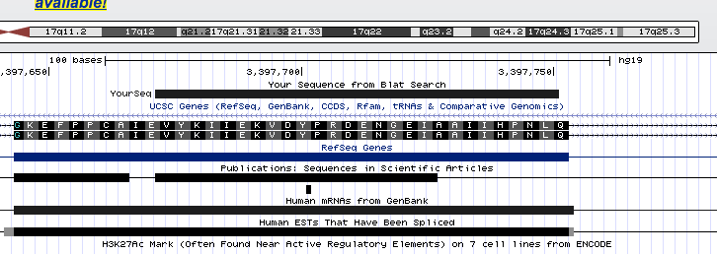
Challenges in actually interpreting – “version hell”.
Variant is actually a T.
Snpedia says A is the problematic variant, but that’s on hg38.
On hg19, which is what variants were called on, relevant gene is on reverse strand so T => A.

Slide 30
Human migrations into Europe (~40kya – fall of Roman Empire)
Veeramah and Novembre, doi:10.1101/cshperspect.a008516

Slide 31
Human genetic comparisons overlayed on map of Europe.
Veeramah and Novembre, doi:10.1101/cshperspect.a008516

Slide 32
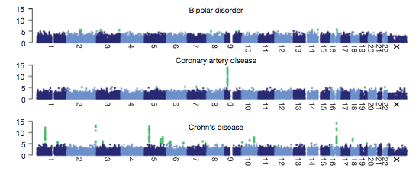
Predicting new disease variants:
Can we find associations between variants and diseases?
“Genome Wide Association Study (GWAS)”
Wellcome Trust CCT, 2007, doi:10.1038/nature05911

Slide 33
…cautions of GWAS:
Need to account for relatedness in samples;
Large sample sizes needed;
Complex statistics needed & “multiple testing” issues;
Different identifier/database mixtures;
Correlation is not causation;
Large effects are rare – typically many small signals combined.
The data science problem from hell!

Slide 34
Where next?
Short-term: next 2-5 years
Medium-term: 10 years
Long-term: 20 years+

Slide 35
Short term
Lots more data! “Millions to billions of human genomes” coming.
Individual data – est 300,000 human genomes sequenced in 2014.
Tumor and somatic data.
Time course data (“narcissome”) - Mike Snyder
Newer sequencing data types – e.g. longer reads.
see: http://www.nature.com/news/the-rise-of-the-narciss-ome-1.10240

Slide 36
Short-term software problems
Increasingly many open source Python projects (bcbio, Gemini);
Help with integration between tools (dependency hell, versioning hell);
Optimization of specific approaches not so important.
Lack of concordance => technical problem.
General speed ~meh
Flexible and robust libraries still maturing.

Slide 37
Medium term
We’ll be sequencing everything all the time (but still won’t really know what it means); => data integration and data mining.
Large scale sequencing is rapidly being extended to agriculture, ecology, and veterinary medicine.
We will soon be able to “edit” whatever genomes we want (check out CRISPR), but will not have a good idea of what to actually edit (c.f. Perl8 analogy, above).
Read up on “gene drive” if you want the bejeezus scared out of you:
http://news.sciencemag.org/biology/2015/03/chain-reaction-spreads-gene-through-insects

Slide 38
Longer term
No one knows.
We’ve only had large scale sequencing & the human genome for ~15 years!!
Free associate the following:
cheap sequencing; quantified self; Internet of Things.

Slide 39
How to get involved?
A lot of the software is open source!
(bwa, samtools, etc. etc.)
…but:
Warning: genomics is large, and deep, and largely invisible, and has its own culture.
Sadly, your best bet is probably to come do a PhD with someone like me, for free.
(just kidding! …)

Slide 40
bcbio and Gemini
Help with:
Gemini: SQLite to PostgreSQL conversion;
Gemini: “bigwig” parsing performance;
bcbio: improving use & cleanliness of Cloud port
bcbio: moving to Common Workflow Language (note, reference implementation in Python)
See talk blog post at http://ivory.idyll.org/2015-pycon-talk.html for more info.

Slide 41
How can you sequence your own genome?
Most genetic testing services (23andme, etc.) don’t actually sequence your 6 billion bases of DNA; they instead use a more targeted approach and look at common variants or known disease variants.
If it costs < $1000, they’re not actually sequencing you :)
DNA extraction, etc, is fairly straightforward if you have access to a lab and the necessary expertise.
Main suggestion: see http://www.personalgenomes.org/

Slide 42
Thanks for coming!
Please see links to data, instructions, and more reading at
http://ivory.idyll.org/blog/2015-pycon-talk.html

